Slide 1


Identification of low Impedance Faults in a power system network using FFT for different values of Ground Resistance
By
Sayan Das 101
Ritesh Majumdar 103
Arindam Pal 104
Nilay Dey 105
Mirutnjay Kumar 106
Under the guidance of
Dr. Nabamita Banerjee Roy
(Associate professor EE dept.)

Slide 2
Contents
Introduction
Power System Faults
Fast Fourier Transform (FFT)
Simulation of Low Impedance Faults in a Power System Network
Application of FFT in Fault classification
Results and Discussions
Conclusion And Future scope of work

Slide 3
Introduction
Transmission line faults are the most common faults, triggered by falling trees across lines, lightning strikes or insulator strings to flash over.
Faults on power transmission lines need to be detected and located rapidly, classified correctly and cleared as fast as possible.
Distance relays are normally used to protect transmission lines. The impedance between the relay location and the fault location that is fairly constant, these relays respond to the distance to a fault on the transmission line.
So during the course of recent years, the development of the fault diagnosis for the transmission line has been progressed with the applications of signal processing techniques which is also the objective of this project work.
The proposed technique is based on FFT

Slide 4
Power System Faults
The electrical power system is very large, complex and spread over a large geographical area. The electrical power system consists of a generator, transformer, transmission lines and load. A fault in a circuit is the disturbance or failure, which interfere the normal system operation.
Fault usually occurs in a power system due to insulation failure, flashover, physical damage such as wire blowing together in the wind, an animal coming in contact with the wire.
Fault usually causes the flow of excessive current, abnormal voltages, induce overvoltage on neighbouring equipment and cause hazards to human, animals, etc.
Electrical faults in three-phase power system mainly classified into two types, namely open and short circuit faults.

Slide 5
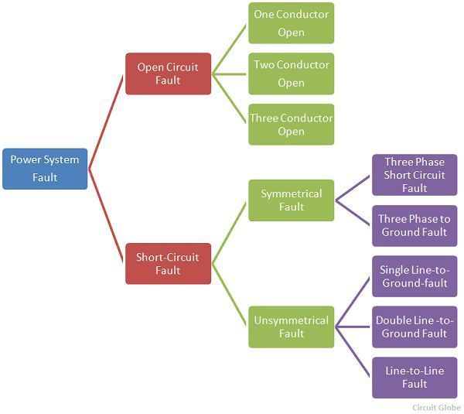
Power System Faults contd.

Slide 6
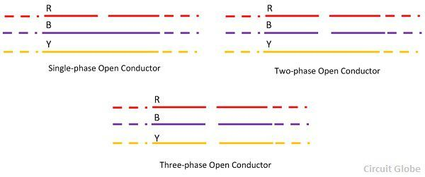
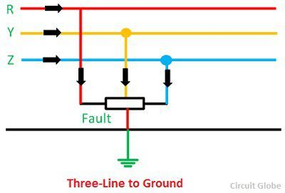
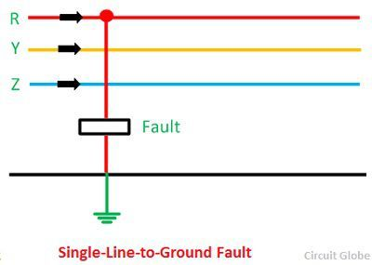
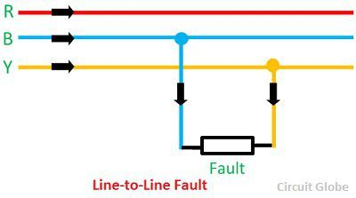
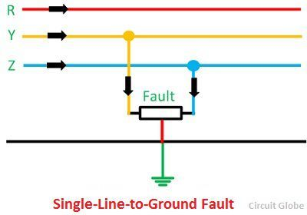
Power System Faults contd.
Types of Faults | Causes | Effects
Open circuit | Broken conductor and malfunction of circuit breaker in one or more phase | Abnormal operation of the system Danger to the personnel as well as animals
Short Circuit | Internal effects include breakdown of transmission lines or equipment, aging of insulation, deterioration of insulation in generator, transformer and other electrical equipment, improper installations and inadequate design. | Arcing faults can lead to fire and explosion in equipment's such as transformers and circuit breakers. The power flow is severely restricted or even completely blocked as long as the short circuit fault persists.

Slide 7
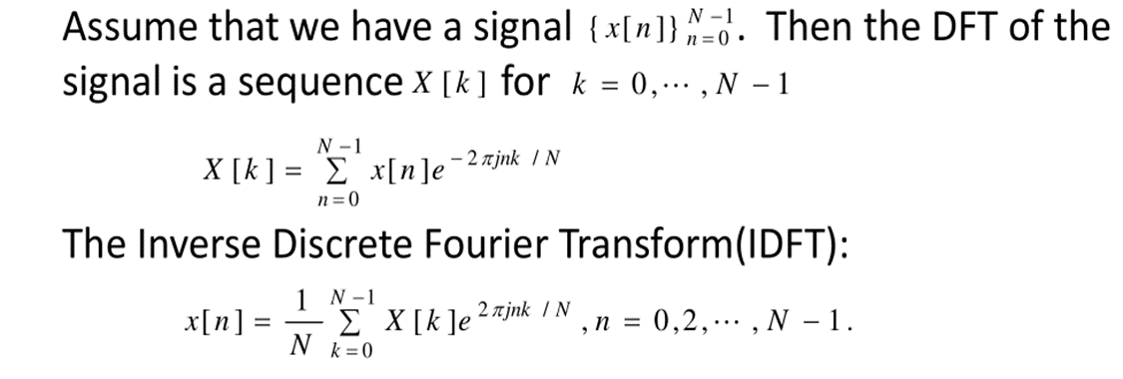

Fast Fourier Transform (FFT)
Using the Fourier series representation we have Discrete
Fourier Transform (DFT) for finite length signal
DFT can convert time‐domain discrete signal into frequency‐
domain discrete spectrum
N= Signal Length
T= Sampling time interval

Slide 8
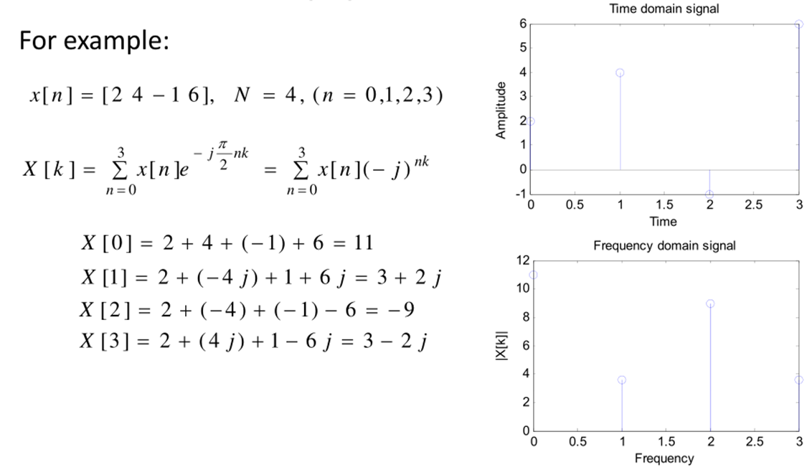
FFT contd.
The Fast Fourier Transform does not refer to a new or different
type of Fourier transform. It refers to a very efficient algorithm for
computing the DFT
The time taken to evaluate a DFT on a computer depends
principally on the number of multiplications involved. DFT needs
principally on the number of multiplications involved. DFT needs
N2 multiplications. FFT only needs Nlog2(N)

Slide 9
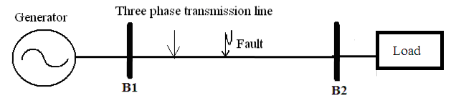
Simulation of Low Impedance Faults in a
Power System Network
Single Line diagram of 400 kV, 50 Hz, 3-phase power system network.
Simulation parameters and conditions
Sampling time: 78.28 μs.
Time period of simulation in MATLAB: 0.06secs.
Sampling frequency: 12.8 kHz.
Ten types of faults simulated : AG, BG, CG, AB, BC, CA, ABG, BCG, CAG, LLL.
Faults initiated at 29 different locations starting from B1, each being 10 km apart.

Slide 10
System parameters
System Components | Specifications
Generator | Impedance = (0.2+j4.49) Ω, X/R ratio = 22.45.
Transmission Line | Length: 300 Km , R1 = 0.02336Ω/km, R2 = 0.02336Ω/km, R0 = 0.38848Ω/km, L1 = 0.95106mH/km, L2 = 0.95106mH/km, L0 = 3.25083mH/km, C1 = 12.37nF/km, C2 = 12.37nF/km, C0 = 8.45 nF/km
Balanced Load | Load Impedance = (720+j11)Ω, p.f.= 0.9, MVA rating = 200

Slide 11
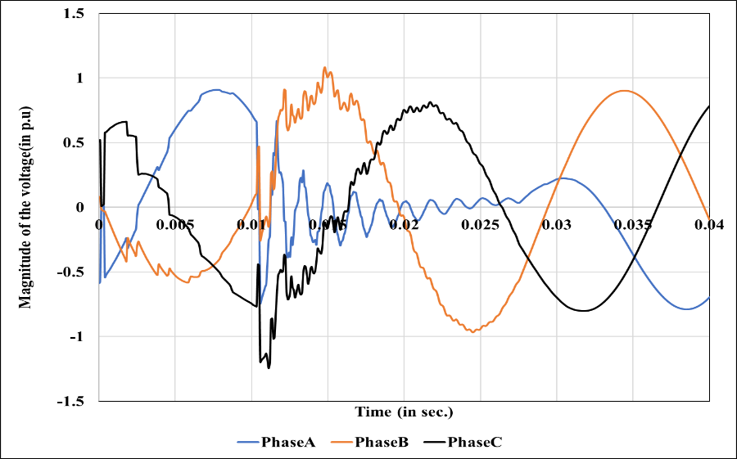
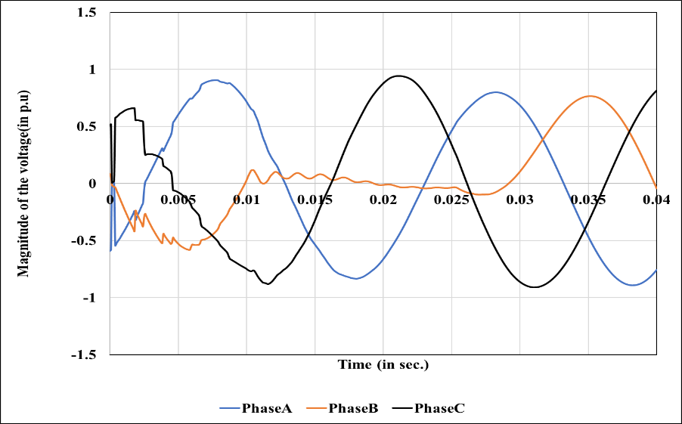
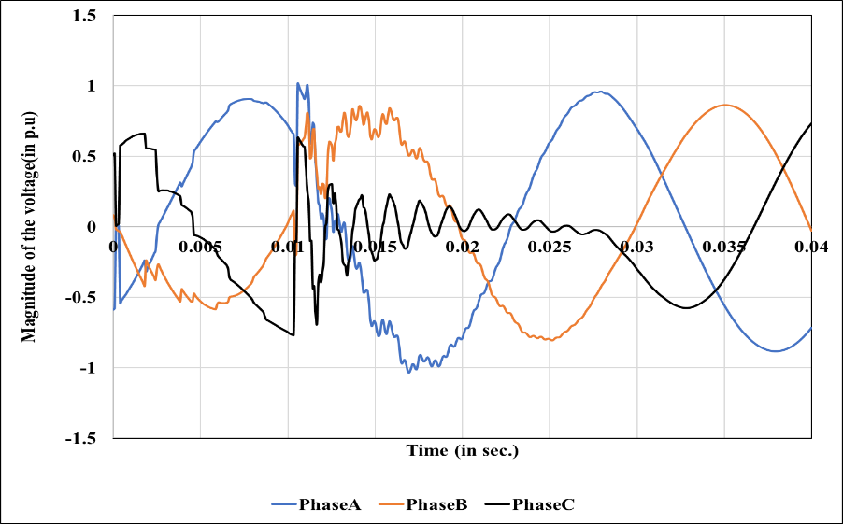
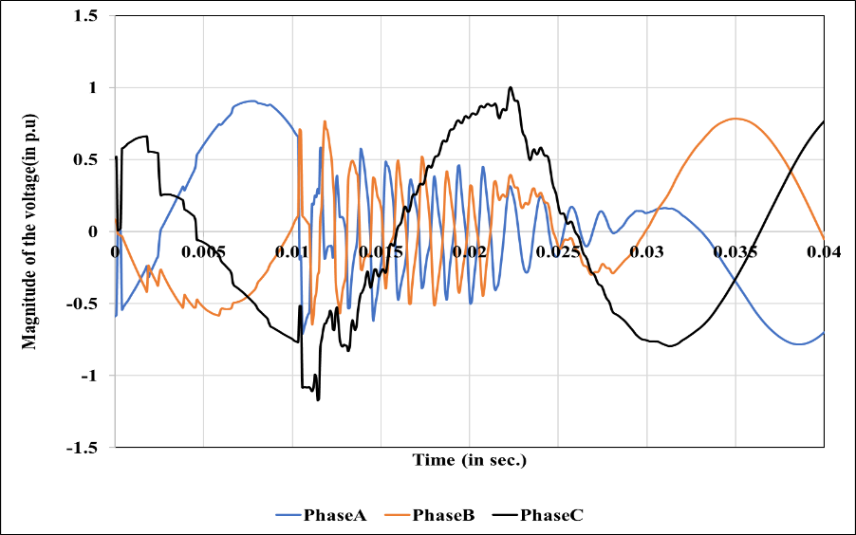
Simulation of Faults
Voltage profiles of the three phases for (1) AG, (2) BG, (3) CG and (4) ABG types of faults at 100 km from B1, R_{F} = 5Ω, θ = 0⁰
1). 3 Phase Voltage Waveform during AG type fault occurring at 100 km from sending end B1 with ground resistance 5 ohm
2). 3 Phase Voltage Waveform during BG type fault occurring at 100 km from sending end B1 with ground resistance 5 ohm
3). 3 Phase Voltage Waveform during CG type fault occurring at 100 km from sending end B1 with ground resistance 5 ohm
4). 3 Phase Voltage Waveform during ABG type fault occurring at 100 km from sending end B1 with ground resistance 5 ohm
(c) (d)

Slide 12
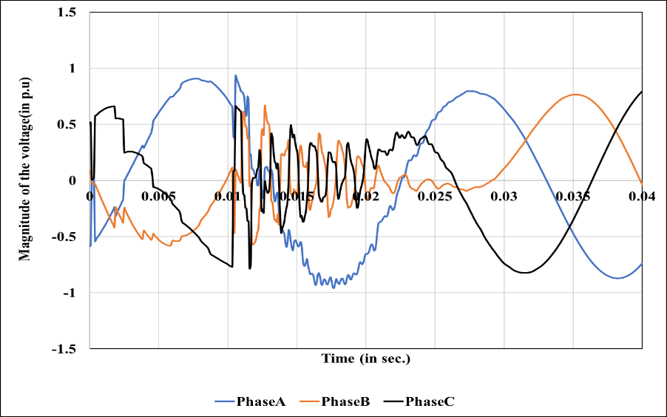
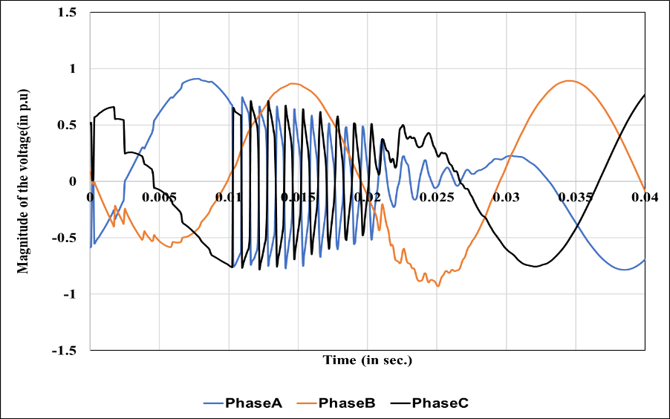
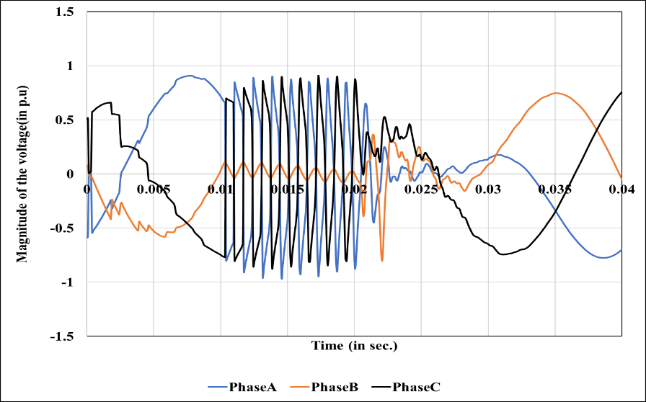
Simulation of Faults
Voltage profiles of the three phases for (5) BCG, (6) CAG, and (7) ABCG types of faults at 100 km from B1, R_{F} = 5Ω, θ = 0⁰
5). 3 Phase Voltage Waveform during BCG type fault occurring at 100 km from sending end B1 with ground resistance 5 ohm
6). 3 Phase Voltage Waveform during CAG type fault occurring at 100 km from sending end B1 with ground resistance 5 ohm
7). 3 Phase Voltage Waveform during ABCG type fault occurring at 100 km from sending end B1 with ground resistance 5 ohm
(c) (d)

Slide 13
Application of FFT in Fault Classification
Method of analysis :
FFT has been implemented on the voltage waveform of each phase simulated at the sending end of the network during a fault condition the output of the FFT is a complex matrix. The absolute value of the FFT matrix is obtained which is referred to as the frequency spectrum of the voltage waveform. The frequency spectrum of voltage during kinds of fault shown in fig.
The maximum value of every spectrum is noted as an important feature for classification of fault in the present study. The process is respected for all the types of faults at different location of the transmission line.

Slide 14
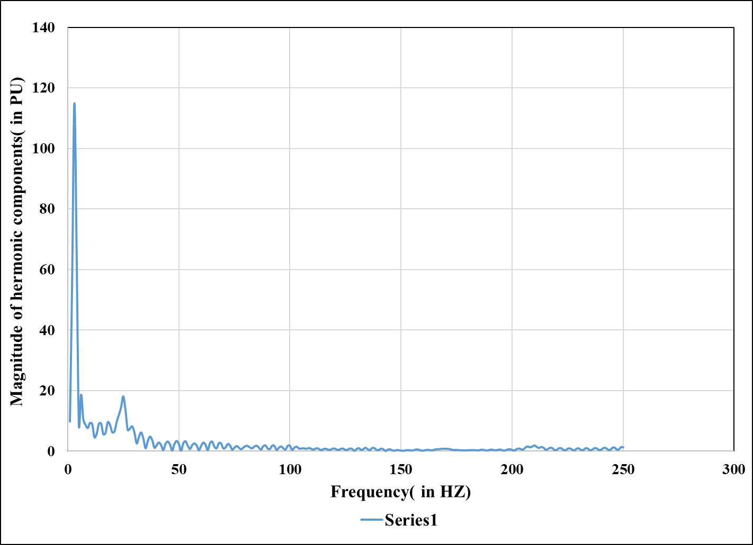
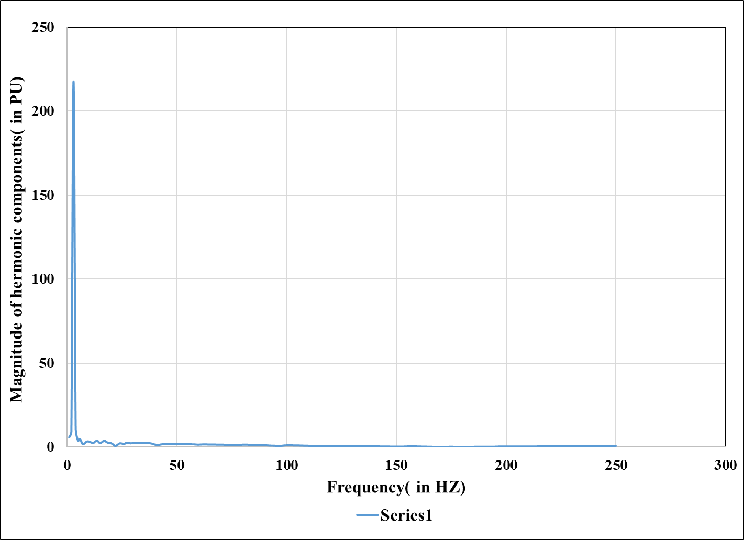
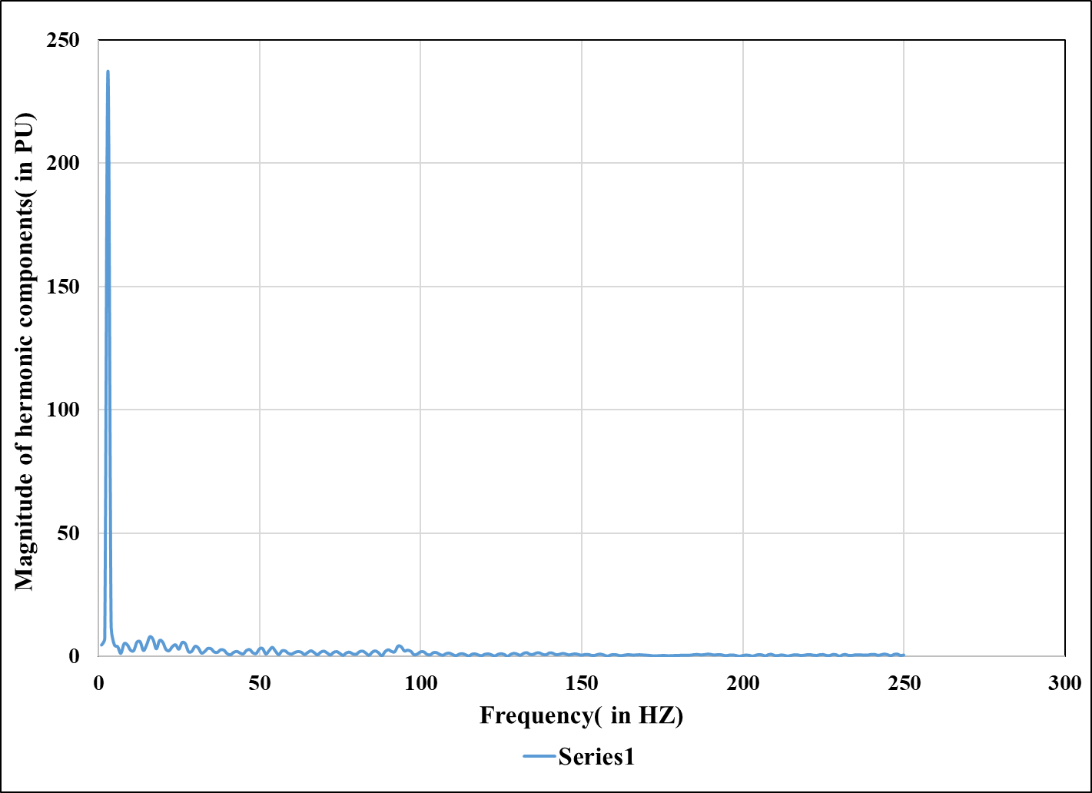
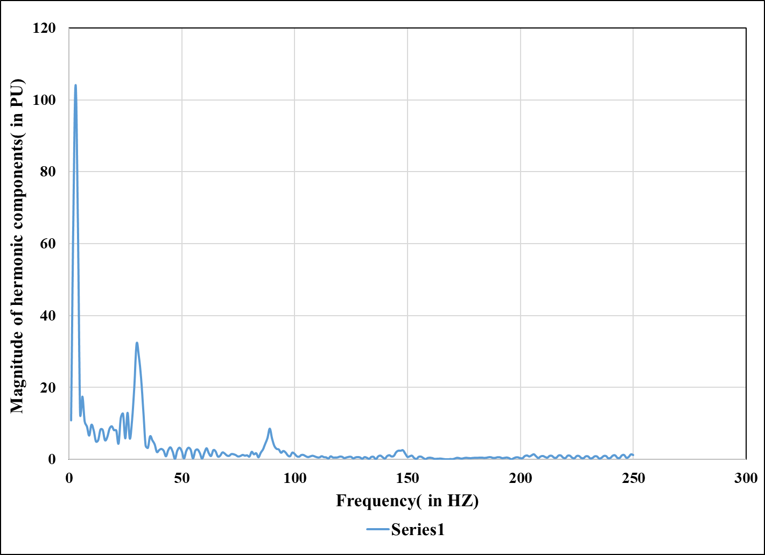
Plots of Frequency Spectrum
1: Frequency spectrum of the voltage signal of phase A during AG type of fault occurring at 100 km from the sending end of the power system
2: Frequency spectrum of the voltage signal of phase B during BG type of fault occurring at 100 km from the sending end of the power system
3: Frequency spectrum of the voltage signal of phase C during CG type of fault occurring at 100 km from the sending end of the power system
4: Frequency spectrum of the voltage signal of phase A during ABG type of fault occurring at 100 km from the sending end of the power system

Slide 15
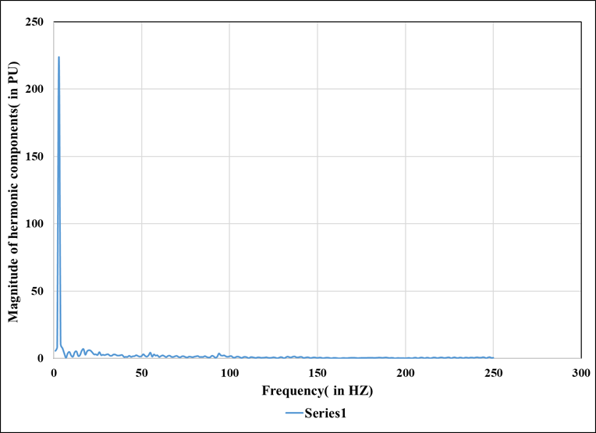
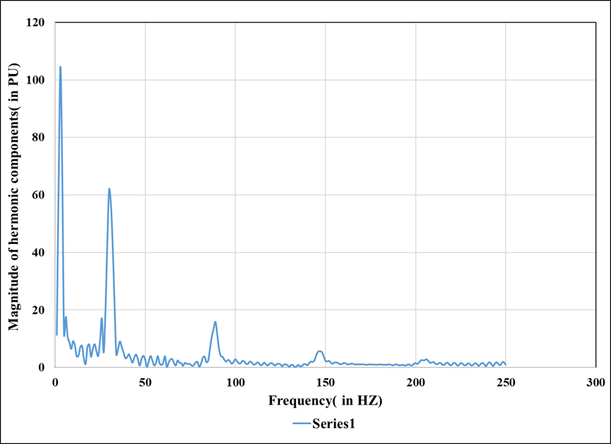
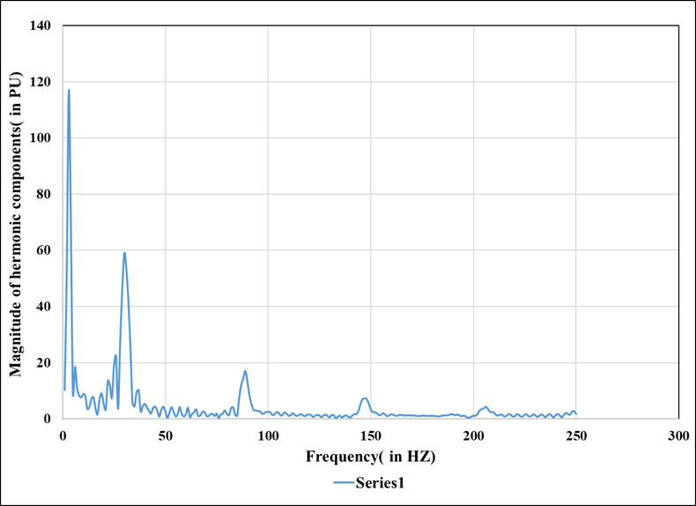
Plots of Frequency Spectrum
5: Frequency spectrum of the voltage signal of phase B during BCG type of fault occurring at 100 km from the sending end of the power system
6: Frequency spectrum of the voltage signal of phase C during CAG type of fault occurring at 100 km from the sending end of the power system
7: Frequency spectrum of the voltage signal of phase A during ABCG type of fault occurring at 100 km from the sending end of the power system

Slide 16
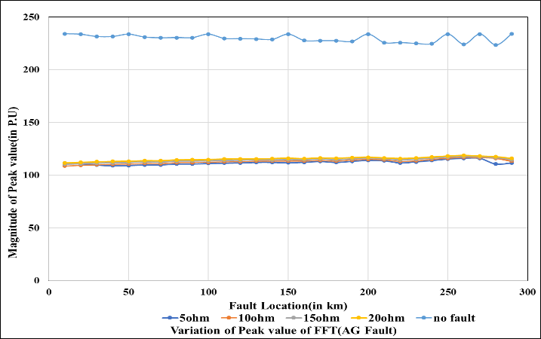
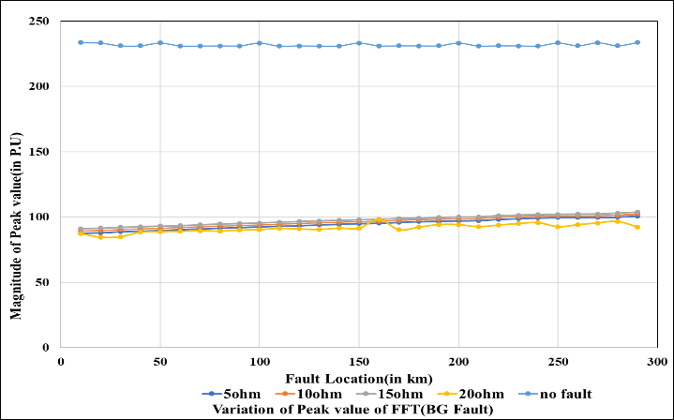
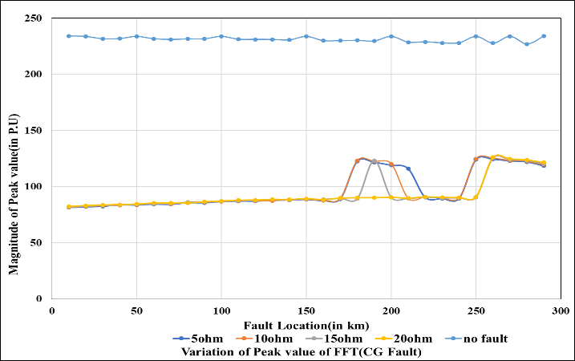
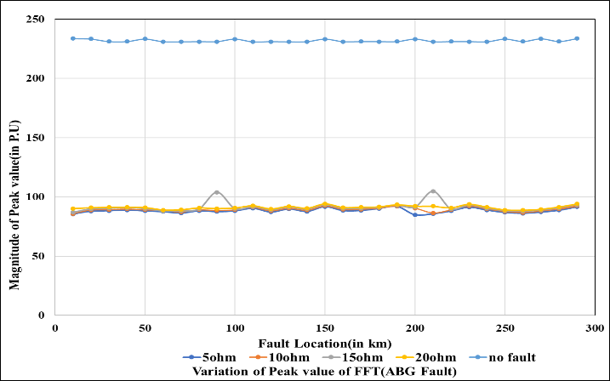
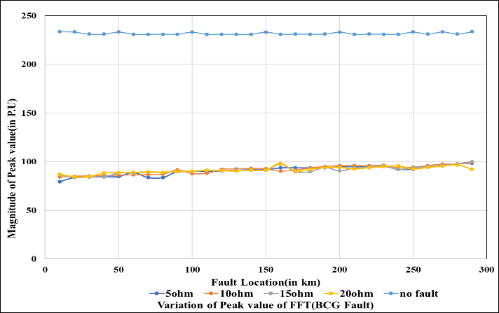
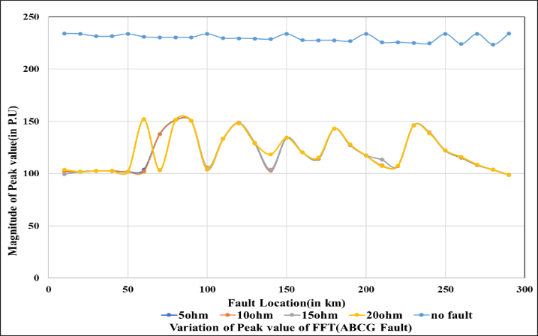
Plots of Signal Features obtained by FFT
With respect to different fault location and ground resistance are 5,10,15 and 20 ohm
Plots of magnitudes of features obtained from FFT with respect to fault location in case of AG fault (phase A)
Plots of magnitudes of features obtained from FFT with respect to fault Location in case of BG fault (phase B)
Plots of magnitudes of features obtained from FFT with respect to fault location in case of CG fault (phase C)
Plots of magnitudes of features obtained from FFT with respect to fault location in case of ABG fault (phase B)
Plots of magnitudes of features obtained from FFT with respect to fault location in case of BCG fault (phase A)
Plots of magnitudes of features often from FFT with respect to fault location in case of ABCG fault (phase A)

Slide 17
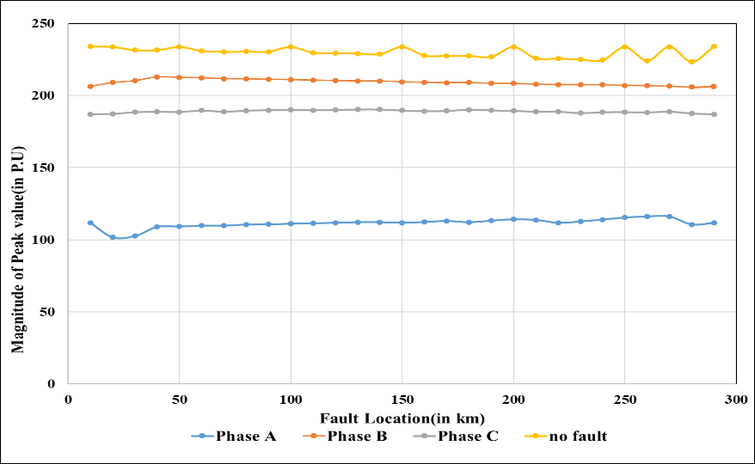
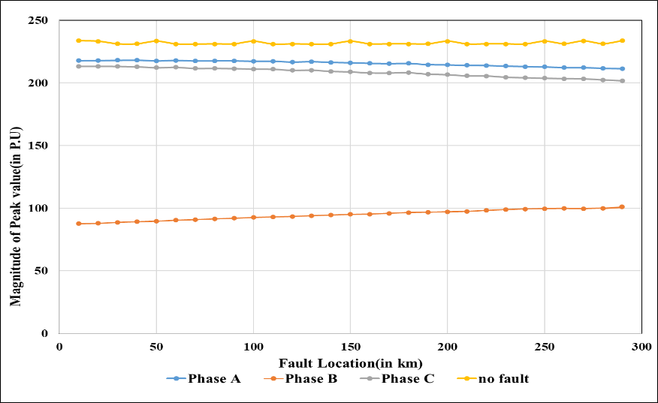
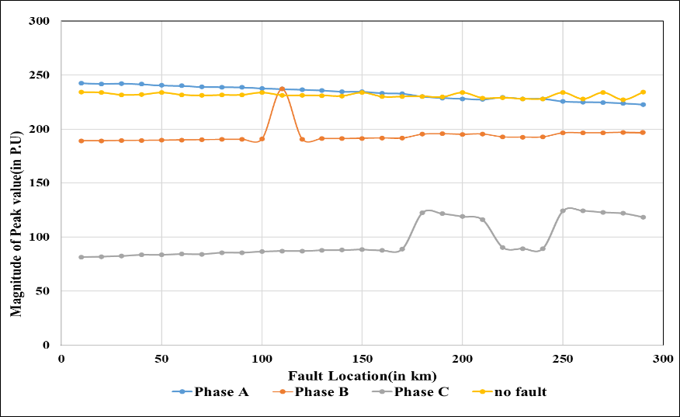
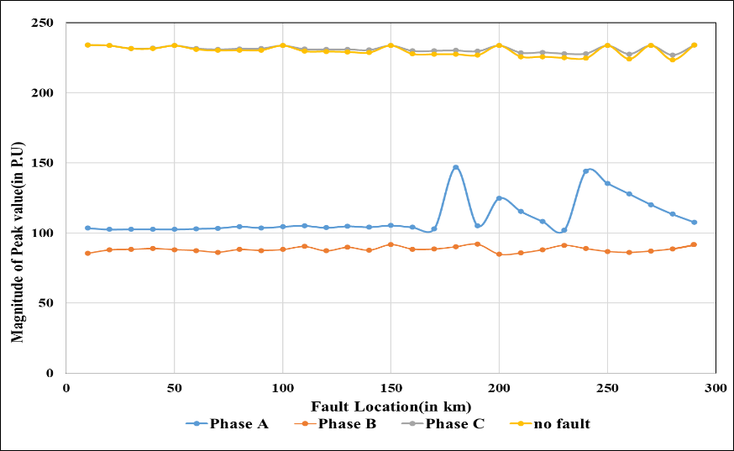
Plots of Signal Features of 3 Phase for 5 ohm Ground resistance
Plots of magnitudes of features obtained from FFT with respect to fault location in case of AG type of fault for the three phases with ground resistance 5 ohm
Plots of magnitudes of features obtained from FFT with respect to fault location in case of BG type of fault for the three phases with ground resistance 5 ohm
Plots of magnitudes of features obtained from FFT with respect to fault location in case of CG type of fault for the three phases with ground resistance 5 ohm
Plots of magnitudes of features obtained from FFT with respect to fault location in case of ABG type of fault for the three phases with ground resistance 5 ohm

Slide 18
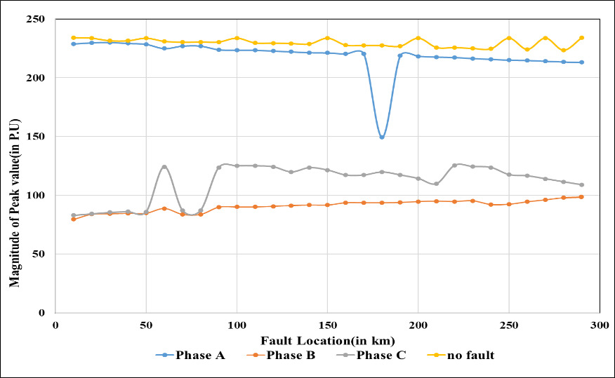
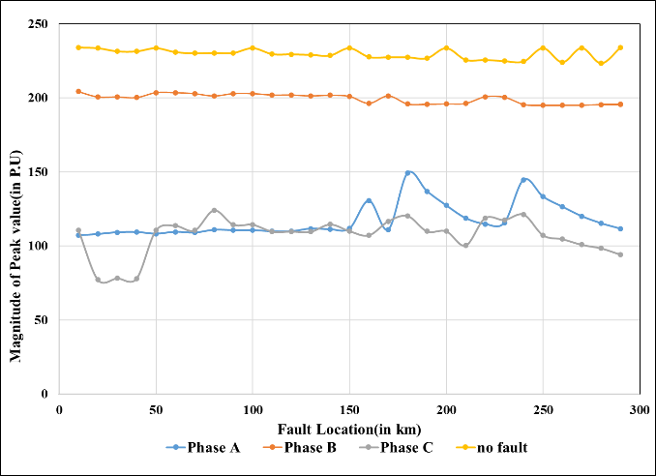
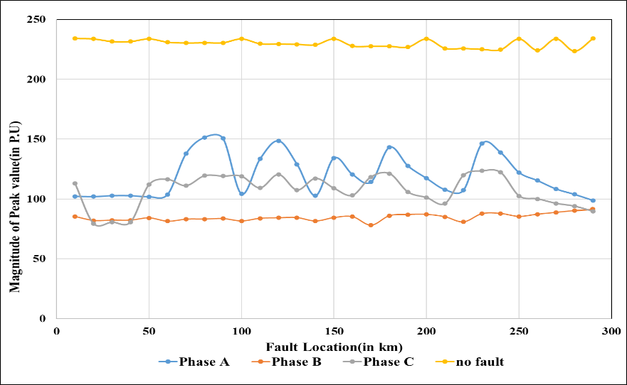
Plots of Signal Features of 3 Phase for 5 ohm Ground resistance
Plots of magnitudes of features obtained from FFT with respect to fault location in case of BCG type of fault for the three phases with ground resistance 5 ohm
Plots of magnitudes of features obtained from FFT with respect to fault location in case of CAG type of fault for the three phases with ground resistance 5 ohm
Plots of magnitudes of features obtained from FFT with respect to fault location in case of ABCG type of fault for the three phases with ground resistance 5 ohm

Slide 19
Results and Discussions
Name of Faults | Magnitude of Features in comparison to the feature of the voltage Signal during no fault condition.
 | Phase A | Phase B | Phase C
AG | Lowest | Lower than normal value | Lower than normal value
BG | Lower than normal value | Lowest | Lower than normal value
CG | Same as normal value | Lower than normal value | Lowest
ABG | Lowest | Lowest | Same as normal value
BCG | Same as normal value | Lowest | Lowest
CAG | Lowest | Lower than normal value | Lowest
ABCG | Lowest | Lowest | Lowest

Slide 20
Conclusion and Future Scope of Work
In the present work, different types of short circuit faults have been simulated with fault resistance 0 ohm and different values of Ground resistances, ranging from 5 ohm ,10 ohm,15 ohm and 20 ohm respectively.
As the ground is involved, hence only L-G, LLG and LLG faults have been simulated. Suitable features have been selected from the voltage signals by using FFT under no fault and different fault conditions
FFT works quite fast as a signal processing tool. The features have been thoroughly studied and it has been observed that the fault conditions can be accurately identified
In the future scope of work, the signal features that have been obtained would be used to train a suitable classifier involving neural network or support vector machine so that fault can be notified automatically under different conditions
The effect of noise on the voltage signals also requires to be studied. The study can be further extended applying other signal processing tools like wavelet transform, for obtaining signal features

Slide 21
Thank you
Stay Safe And Stay Home

